Slide 1
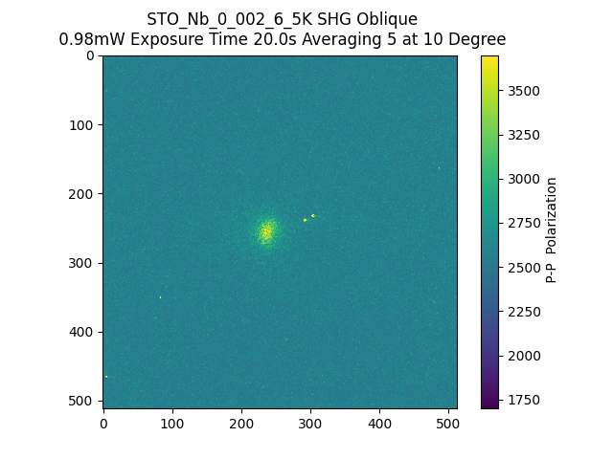
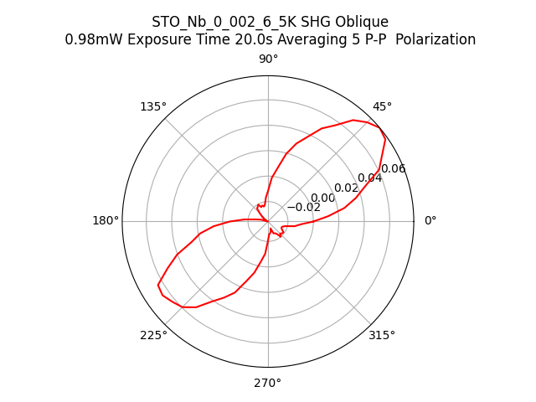
224404_STO_Nb_0_002_6_5K_SHG_Oblique_PP

